Slide 1

Django REST Framework Part 2
Serialization, Deserialization, Mixins, and Decorators
Program: EDGE-CSE CUET DIGITAL SKILLS TRAINING
Course: Python (Django) [Intermediate]
Lecture: Training Session-12 Date: 19th October, 2024 Duration: (1+1) hours
Instructor: Tanveer Rahman, Sr. Software Engineer, Friends Corp. Chuo-ku, Tokyo, JP shakil10vr@hotmail.com, 01626735005

Slide 2
Agenda
Serialization and Deserialization
Mixins in Django REST Framework
Decorators in Django REST Framework
Practical Tasks

Slide 3
Serialization and Deserialization
Serialization:
Deserialization:
Converts complex data types (like Django QuerySets) into native Python data types.
Used for converting data to JSON or XML for API responses.
Converts parsed data back into complex data types.
Used for validating and saving data to the database.

Slide 4
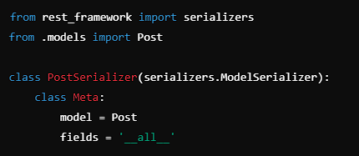
Understanding Serializers
Serializers in Django REST Framework:
Basic Example:
Similar to Django Forms but specifically for transforming and validating data.
Can be used to define fields, validate input, and save data.

Slide 5
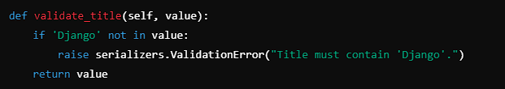
Customizing Serializers
Adding Custom Validation
Overriding create() and update() methods:
For custom save logic.

Slide 6
Task 1 - Serialization and Deserialization (45 mins)
Create a new model and define a corresponding serializer.
Add custom validation to ensure some fields meet specific criteria.
Implement the API view to handle serialization and deserialization.

Slide 7
Introduction to Mixins
What Are Mixins?
Commonly Used Mixins in DRF:
Predefined classes providing default behavior for common operations.
Simplify CRUD operations for API views.
CreateModelMixin, ListModelMixin, RetrieveModelMixin, UpdateModelMixin, DestroyModelMixin.

Slide 8
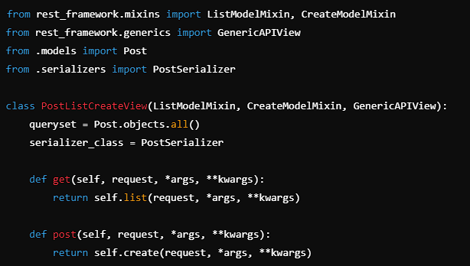
Using Mixins with Generic Views
Combining Mixins with Generic Views:

Slide 9
Task 2 - Implementing Mixins (30 mins)
Refactor an existing API view to use Mixins for common operations.
Combine multiple mixins to handle GET, POST, PUT, and DELETE requests.

Slide 10
Introduction to Decorators
What Are Decorators?
Commonly Used Decorators in DRF:
Functions that wrap another function or method to extend its behavior.
@api_view for function-based views. @permission_classes to specify permissions. @action for creating custom actions in viewsets.

Slide 11
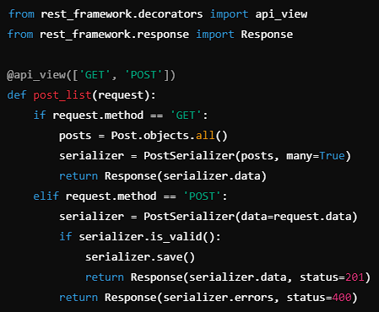
Using the @api_view Decorator
Example for Function-Based Views:

Slide 12
Task 3 - Implementing Decorators (30 mins)
Create a function-based view using the @api_view decorator.
Add custom permission classes using the @permission_classes decorator.
Create a custom action using the @action decorator in a viewset.

Slide 13
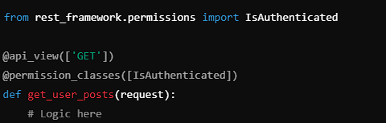
Advanced Decorator Usage
@permission_classes Decorator:
Custom Decorators:
Used to specify permission classes for views.
Example:
Can be defined to extend view functionality.

Slide 14
Recap
Serialization & Deserialization: Transform data between native Python types and complex types.
Mixins: Provide a simpler way to implement CRUD operations.
Decorators: Extend the behavior of function-based views and customize functionality.

Slide 15
Additional Resources
Django REST Framework Documentation: https://www.django-rest-framework.org/
Python Decorators Guide: https://realpython.com/primer-on-python-decorators/

Slide 16

Q&A Session

